Slide 1
Setting and Theme
How are they related?

Slide 2
What is Setting?
Setting- When and where a story takes place
Location (America)
Time Period (1930’s)
General Situation (great depression)

Slide 3
What does the setting look like
and what mood does it create?
MOOD- The feelings aroused in the reader
Is it colorful? Warm? Bright? (Cheerful)
Is it cold? Dark? Damp? (Nightmarish)
Is it fast pace? Crowded? (Tense)
etc.

Slide 4
What tone is used to create the mood?
Tone- The manner in which an author approaches a subject, the attitude of the writer.
Positive Tone Negative Tone
Cheerful Sarcastic/Critical
Optimistic Hopeless
Romantic Bitter

Slide 5
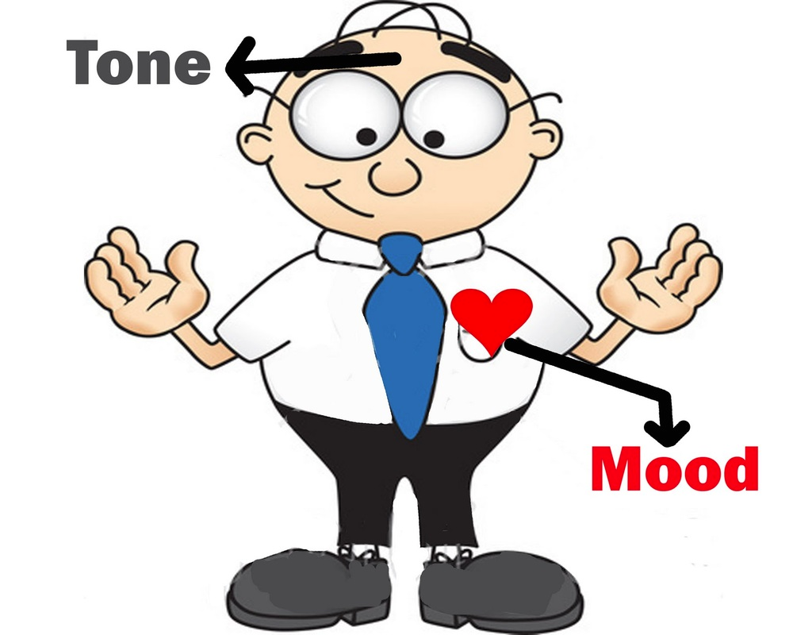
Tone & Mood: What’s the difference?
Whereas the tone deals with what the author thinks about the text, mood deals with how the reader feels.

Slide 6
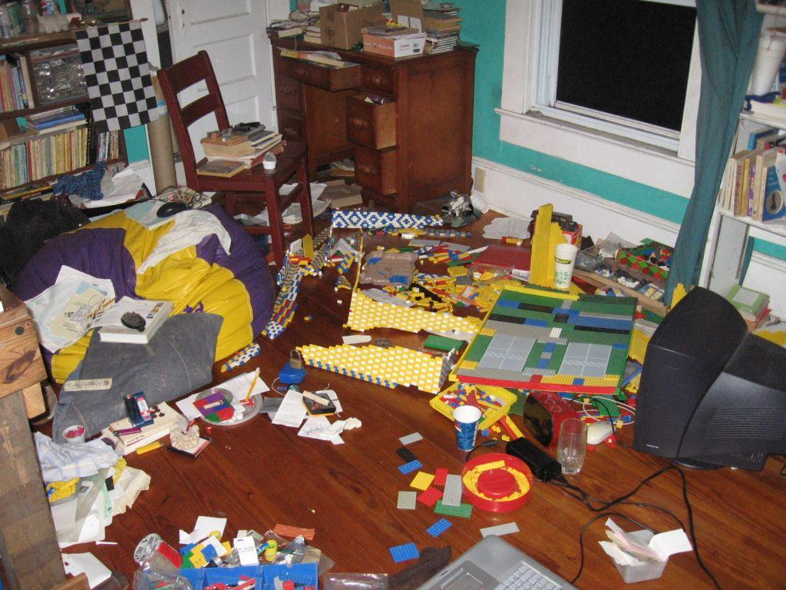
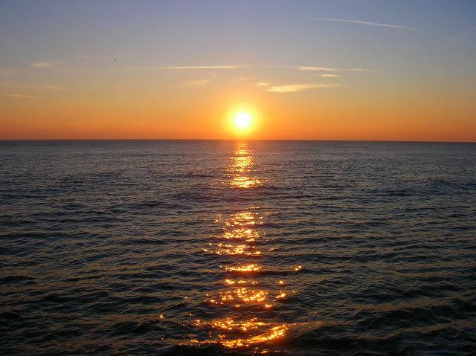
What does location portray?
A Messy Bedroom→ Chaos and disorganization
A Snowy Forest→ Cold and Lonely
Setting Sun on Beach→ Calm and/or death

Slide 7
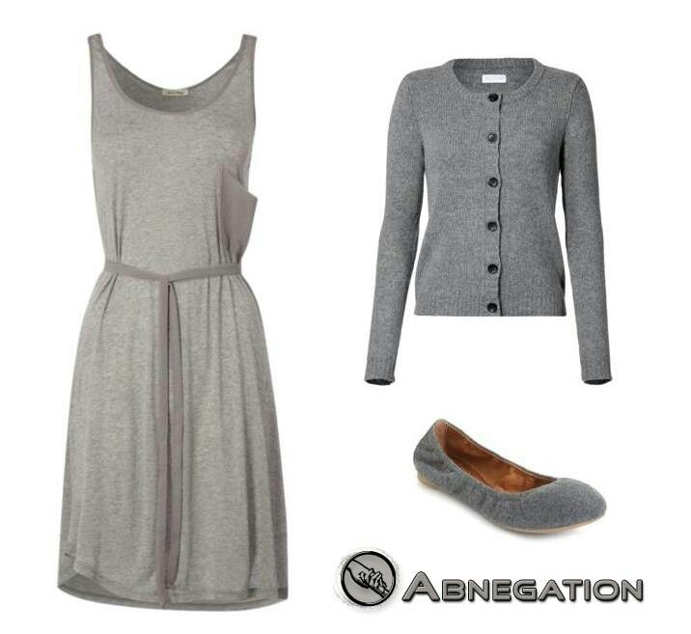
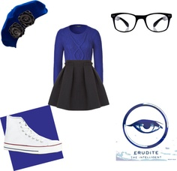
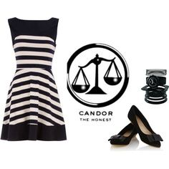
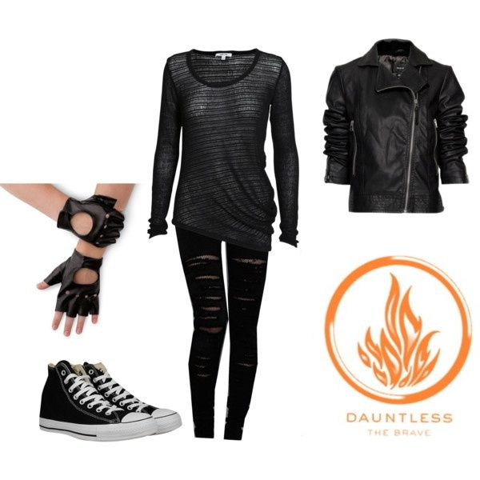
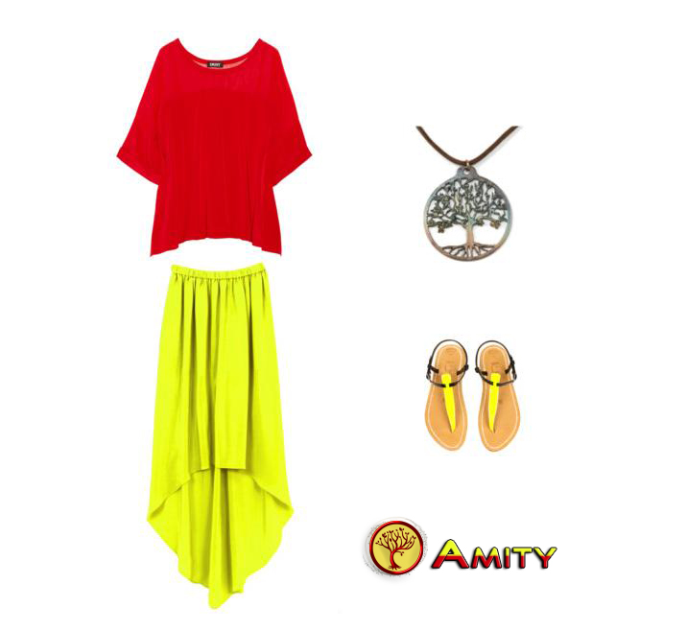
What does clothing say?

